Slide 1



Integrated Program in Business Analytics
Adidas US Sales Clustering
Group A – Batch 13
John Reynolds | Anuj Tiwari| Ashish Mahajan|
Suraj Gutte | Trompess Francis | Simrat Kaur |
Priya Roy | Rahila Rajvada

Slide 2
Agenda
Business Problem and Objectives
Executive Summary
Data Overview and Key Business Assumptions (if any)
Data Preparation and Pre-processing
Sanity checks, treatment and transformations for analytical dataset preparation
Exploratory Data Analysis
Key Business Findings and Insights
Model Development and Validations
Model comparisons on key scoring metrics and model finalization
Dashboarding (required only when it is in scope of analysis)
Businesss Recommendations and Potential Business Impact
Next Steps
Appendix

Slide 3

Business Problem
Understand and segment the Adidas retailer data from across the US market based on various attributes such as type of product purchases, profit, total sales, sales method in order to better facilitate and improve the processes wherever necessary
Primary Objectives
The primary objective of the project is to apply different clustering algorithms to the large dataset help segment the data into smaller groups or clusters. These clusters can then be used by the business to target their marketing/sales activities

Slide 4
About the Dataset
Adidas US sales dataset is a collection of data that includes information on the sales of Adidas products. This type of dataset includes details such as the number of units sold, the total sales revenue, the location of the sales, the type of product sold, and any other relevant information. The general invoice timestamps range from 1/1/2020 to 31/12/2021
Assumptions
The Retailer ID in the data is redundant data as it is not giving any meaningful insight.
Data is authentic / general purpose retail data and inferences may lead to valur to business.
Operating margin is ratio and is treated accordingly

Slide 5
Executive Summary
Segmentation/Clustering of the large retail dataset will enable Adidas to learn past market trends. This new clusters will help the brand learn more about retailers, regions and products and enable them to make tailer-made campaigns to reach its audience.
A data-driven predictive model will be applied to the dataset to identify potential clusters. Different unsupervised machine learning clustering techniques to be applied.
Use of different clustering machine learning techniques will enable us determine, the best model for the dataset and arrive at the best number of the clusters for the available heterogenous data.
Once we have extracted smaller homogeneous groups(clusters), business can focus on targeting activities towards this group.
As new data gets generated, this process should be continued with periodic updates to the data to improve the model and define new clusters

Slide 6
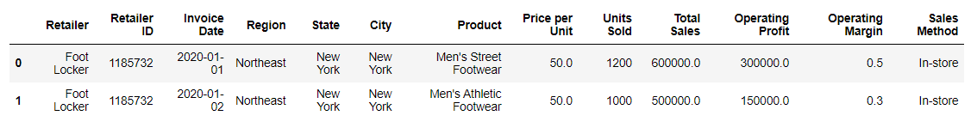
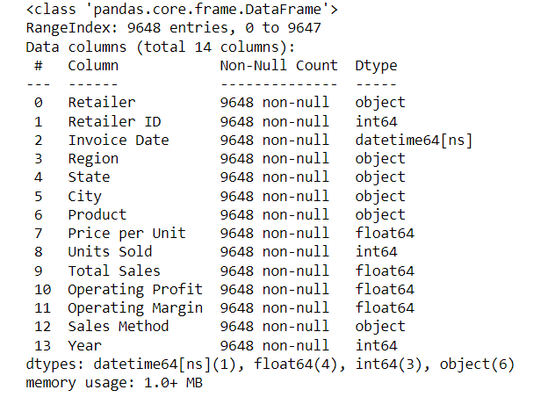
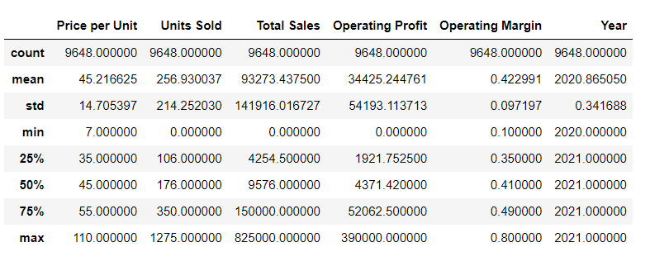
Data Overview

Slide 7
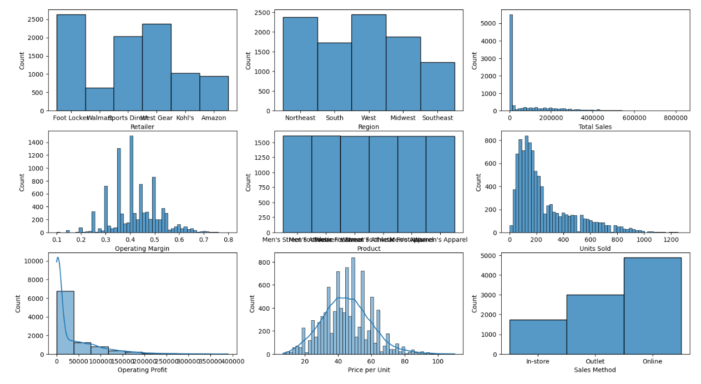
Exploratory Data Analysis - Univariate
Footlocker is the most frequent occurring retailer in the dataset
Total Sales, Operating profit, and Units Sold are interrelated and are right skewed
'Price Per unit' is normally distributed. 'Operating Margin' almost takes the shape of a bell
Online sales are the highest
All products are almost equally distributed
North-east and West contribute to the most observed regions throughout the dataset

Slide 8
Exploratory Data Analysis - Bivariate
Key Highlights
Total Sales % by Retailers
Y-O-Y Growth in Sales
West Gear, Footlocker and Sports Direct occupied ~55% of the total market in terms of sales value in 2021
While Khol’s occupied for 11% share in sales, it registered the highest jump in sales from 2020 by ~100 times
Overall sales grew by 4X from 2020 to 2021, with Amazon being the new entrant in the market in 2021
$ 718 Million
Men’s Street Footwear, Women’s Apparel and Men’s Athletic Foot ware are the top three categories with highest sales value, together accounting for 60% of the total sales
Compared to the year 2020, the sales by categories has been almost similar
The product categories had the similar trend in terms of number of units sold and sales value
Sales by Product Categories in 2021
Price Range
$16 $95
$11 $95
$42 $95
$14 $110
$7 $90
$7 $95
Units Sold
2,45,456 (12%)
3,53,766 (18%)
4,94,134 (25%)
3,53,619 (18%)
2,53,059 (13%)
3,16,478 (16%)

Slide 9
Exploratory Data Analysis - Bivariate
Key Highlights
Product-wise Sales Channel
In-store, Online and Outlet Sales Channel: Men’s street foot ware and women’s apparel, were the top two categories with highest sales value in across all the three channels for 2021
In-store and Online sales channel have the most reach and higher monetization compared to outlet based sales channel
46%
43%
42%
Top 2 product categories with highest OP % generated through different Sales Channel
In sync with the previous analysis, the Operating Profit generated from the three channels, is highest from In-store method, followed closely by Online channel
Clearly, Men’s Street Foot wear and Women’s Apparel, have emerged as the most profitable product categories in 2021
Similarly, Women’s Athletic Footwear, Women’s Street Footwear and Men’s Apparel are the categories with lowest operating margin
Bottom 2 product categories with lowest OP % generated through different Sales Channel

Slide 10
Exploratory Data Analysis - Bivariate
Top two categories by Retailers with Highest Operating Profit share and highest OP margin
AMAZON
FOOT LOCKER
Khol’s
Key Highlights
The graphs represents:
The two of the most efficiently managed categories, due to highest operating profit margin.
It can be logically inferred that, these two categories under respective retailers are the ones where a high proportion of revenues is available to cover non-operating expenses
Highest share in the total Operating profit of the respective retailers for 2021 in the two categories represented in graph:
Amazon - 52% of total OP by Amazon
Foot Locker - 50% of total OP by Foot Locker
Khol’s – 41% of total OP
Sports Direct – 45% of total OP
Walmart – 47% of total OP
West Gear – 44% of total OP
39%
40%
39%
41%
42%
41%
Operating Profit % on categories
Operating Profit % on categories
Operating Profit % on categories
Share in Amazon's total OP
Share in Foot Locker’s total OP
Share in Khol’s total OP
SPORTS DIRECT
WALMART
WEST GEAR
41%
48%
33%
44%
39%
Operating Profit % on categories
Operating Profit % on categories
Operating Profit % on categories
Share in Sports Direct total OP
Share in Walmart’s total OP
Share in Amazon's total OP
40%
Men’s Apparel is the top category to be most efficiently managed by West Gear

Slide 11
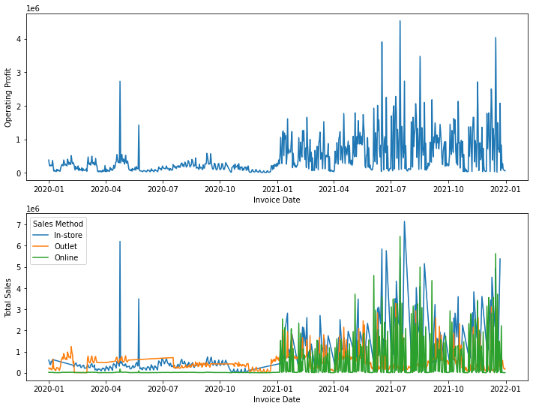
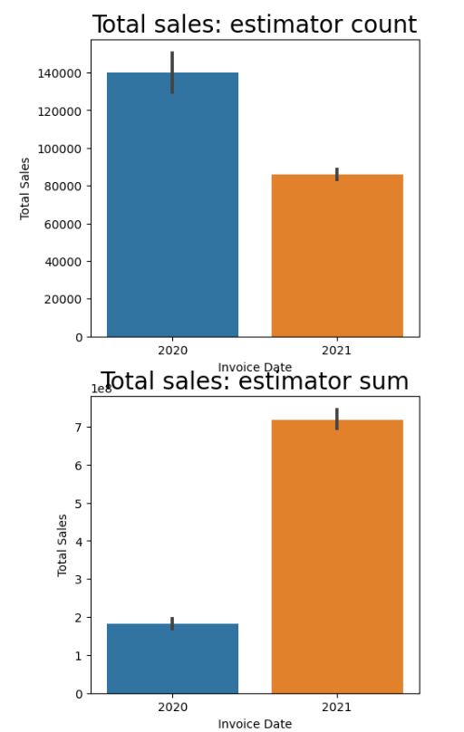
Exploratory Data Analysis Bi-variate Total Sales and Operating Profit
Exploratory Data Analysis - Bivariate
Significant improvement in sales and operating profit is evident in 2021
Less number of transactions and bulk sales evident in 2021
Online sales have surfaced in the year 2021 which can suggest the possible jump in the overall sales

Slide 12
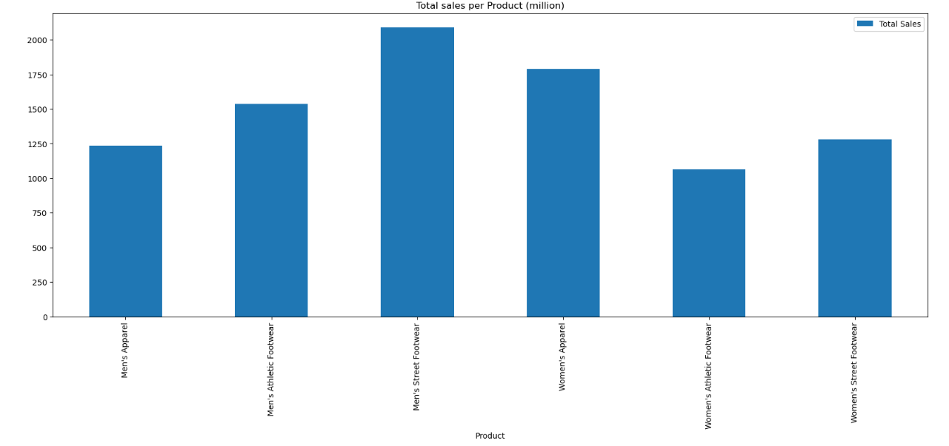
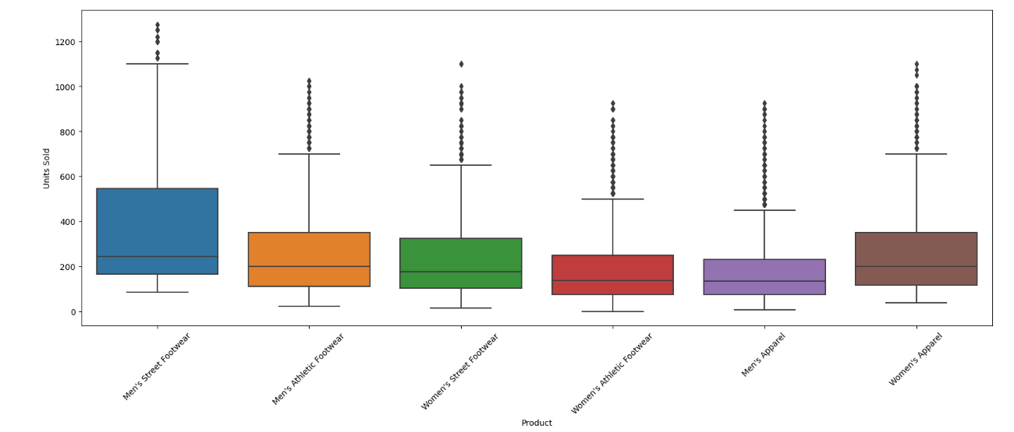
Exploratory Data Analysis - Bivariate
Men’s Street footware followed by Women’s Appareal are leading products.
Visibly huge number of outliers in each product sale data, perhaps the data is mix of retail sale as well as Wholesale for these products. It could be Retail in first year and Wholesale in second year.
Outliers were not treated by us while evaluation of clusters due to exploratory nature of study.

Slide 13
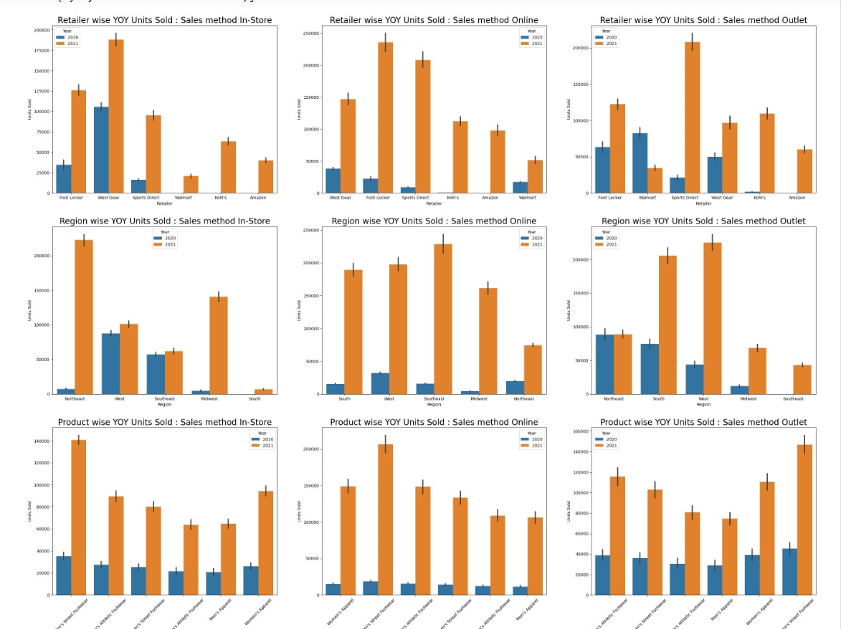
Exploratory Data Analysis – Bivariate – Units Sold
Instore Sales: Walmart, Kohl's and Amazon also initiated in 2021. Existing players took lead in 2021 as well.
Outlet sales: Walmart sale dropped and Sports direct gained the most in 2021. Amazon started sales in 2021.
Online Sales: Growth by all players in 2021, Amazon started in 2021.
Instore sales: Northeast and Midwest gained the most & West and Southeast were almost stagnant.
Outlet Sales: Northeast no sale growth, South east started and West and South gained the most.
Online sales: Growth in all regions. Max gain by Southeast, South, West and Midwest
Product story: Almost unified sale for all products in 2020 in all sales methods. Men's Street footware, Women’s Appareal and Men’s Athletic footware have grown in all considerably in 2021

Slide 14
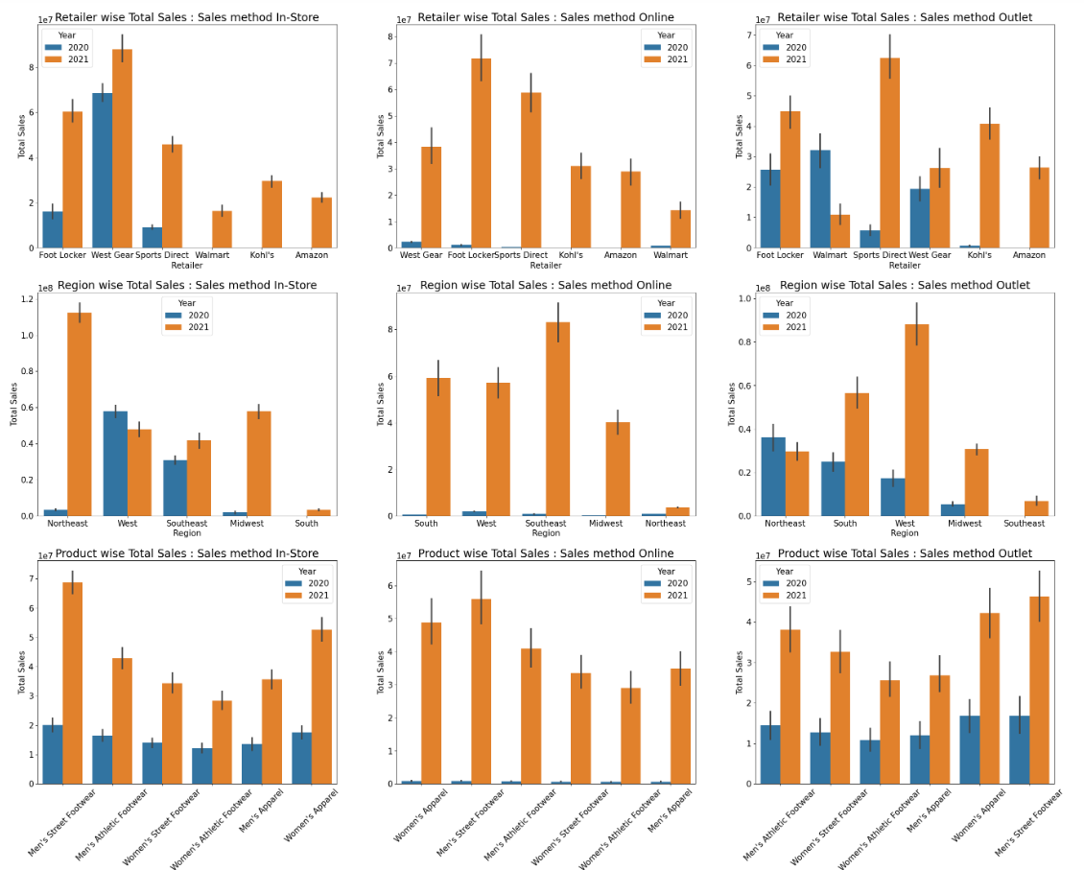
Exploratory Data Analysis – Bivariate – Units Sold
Instore Sales: Walmart, Kohl's and Amazon also initiated in 2021. Existing players took lead in 2021 as well.
Outlet sales: Walmart sale dropped and Sports direct gained the most in 2021. Kohl’s became 3rd largest retailer. Amazon started sales in 2021.
Online Sales: Growth by all players in 2021, Amazon started in 2021.
Instore sales: Northeast and Midwest gained the most & Southeast was not growing much, West sale dropped.
Outlet Sales: Northeast sale dropped, South east started and West and South gained the most.
Online sales: Growth in all regions. Max gain by Southeast, South, West and Midwest
Product story: Almost unified sale for all products in 2020 in all sales methods. Men's Street footware, Women’s Appareal and Men’s Athletic footware have grown in all considerably in 2021

Slide 15
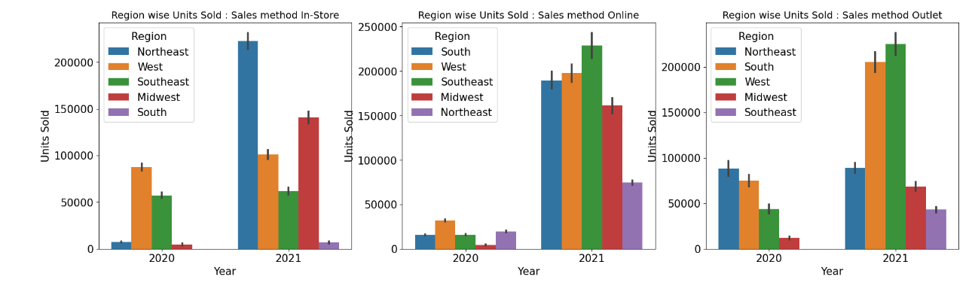
Exploratory Data Analysis
Bivariate – Units Sold - Region & Sales Method
Instore Sales: Phenomenal growth in Northeast sold largest number of units , Midwest also grown better then the rest, almost no growth in Southeast and sales begun in South in 2021.
Online Sales: Massive sale jump in all regions, Southeast sold largest number units, Midwest sold larger qty than Northeast in 2nd year.
Outlet Sales: Remarkable sale improvement in West, South and Midwest, Almost no sales growth in Northeast, sales begun in Southeast in 2021.

Slide 16
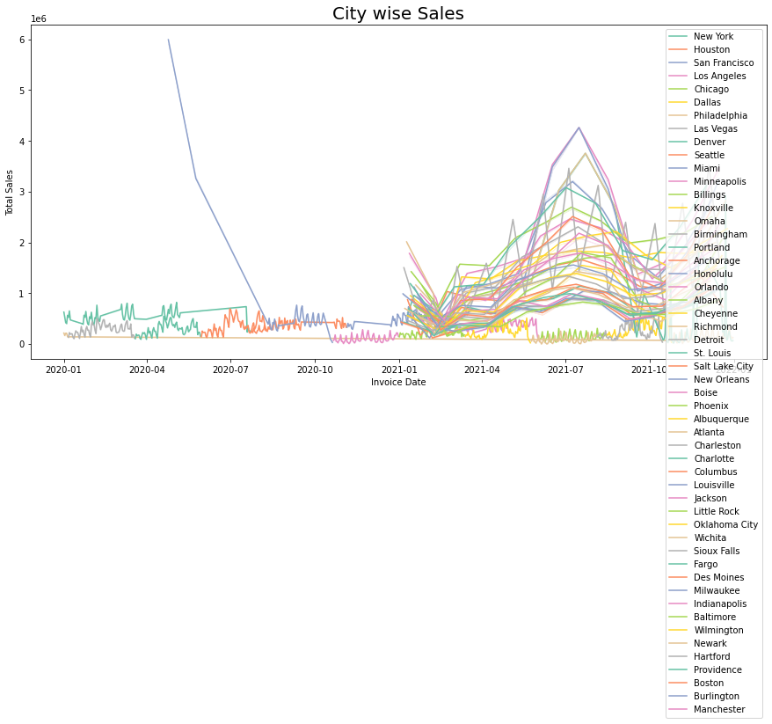
Exploratory Data Analysis
City wise Sales

Slide 17
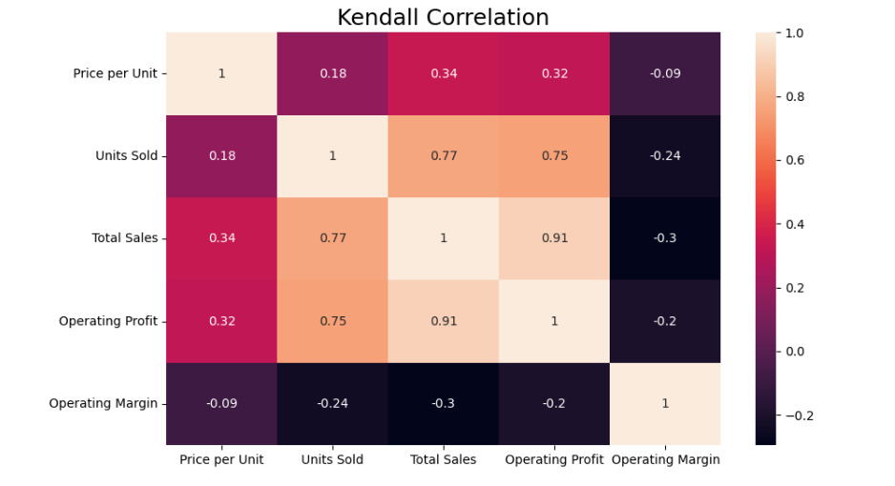
Correlation Plot
Price per unit is positively correlated with Operating Profit, total sales and Units Sold
Total Sales is positively correlated with Operating Profit, units Sold and Price per unit
Negative correlation is evident between Operating margin with Price per unit, Units Sold, Total Sales and Operating Profit

Slide 18
EDA Takeaways

Slide 19
Clustering

Slide 20
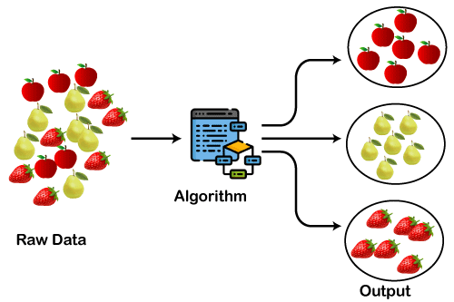
Clustering
Clustering is the process of arranging a group of objects in such a manner that the objects in the same group are more similar to each other than to the objects in any other group. Clustering itself is not one specific algorithm but the general task to be solved. We achieve this goal using various algorithms that differ significantly in their understanding of what constitutes a cluster and how to find them efficiently.
clustering is unsupervised learning and doesn’t use labeled data, we cannot calculate performance metrics. it is an iterative process of information discovery that requires domain expertise and human judgment used frequently to adjust the data and the model parameters to achieve the desired result.
Clustering Algorithms
Applications of Clustering Algorithms
K-Means
K-Prototype Clustering
DBSCAN
Hierarchical Clustering
BIRCH
Mean Shift Algorithm
Gaussian Mixture Model
Customer Segmentation
Retail Clustering
Clinical Management
Image Segmentation
Pattern Recognition
Social network analysis
Image source: https://static.javatpoint.com/tutorial/machine-learning/images/clustering-in-machine-learning.png

Slide 21
K-Means Clustering
Scaling?
PCA ?
silhouette score??

Slide 22
K-Prototype Clustering
Scaling?
PCA ?
silhouette score??

Slide 23
Hierarchical Clustering
Scaling?
PCA ?
silhouette score??

Slide 24
DBSCAN Clustering
Scaling?
PCA ?
silhouette score??

Slide 25
















Criteria For Model Selection
Based on number of Clusters

Slide 26
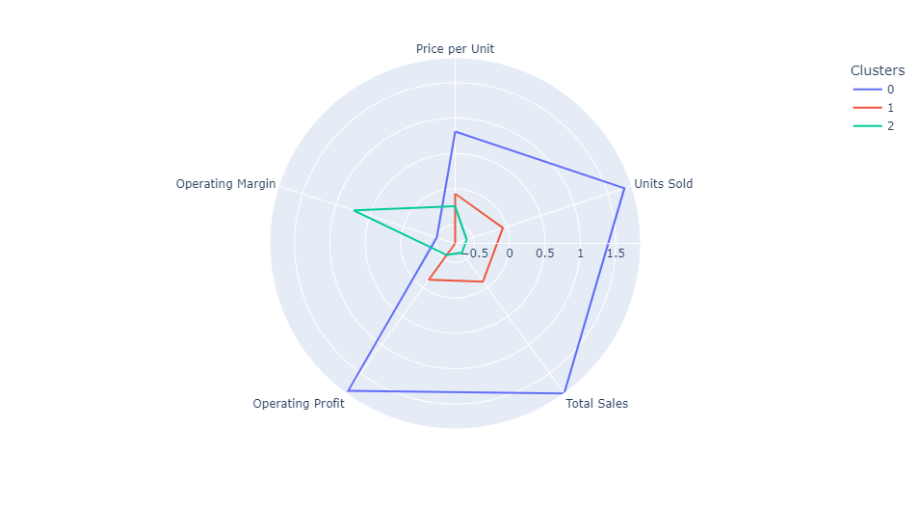
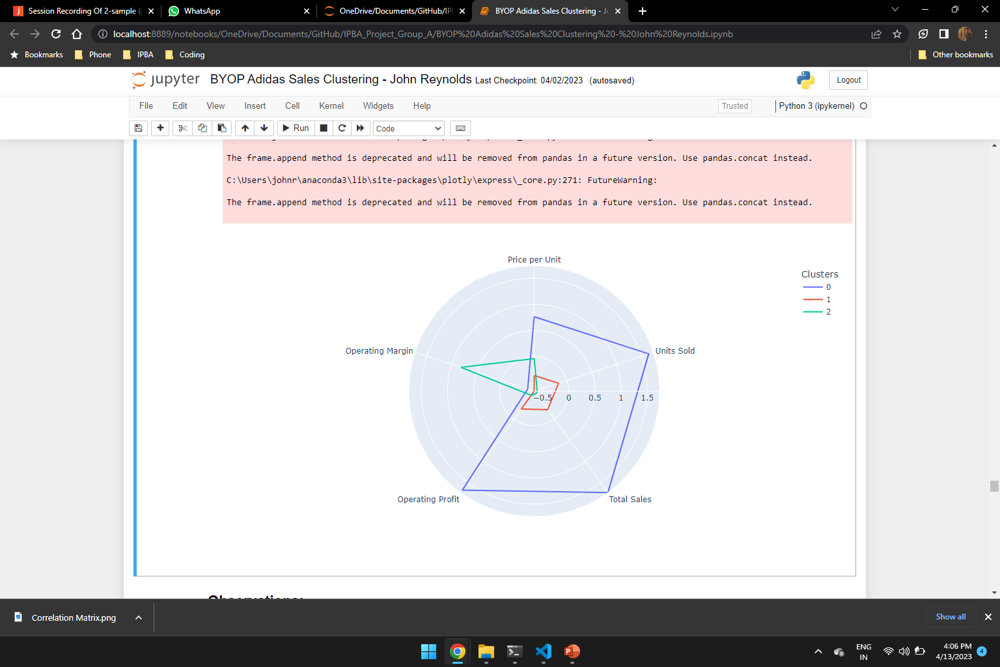
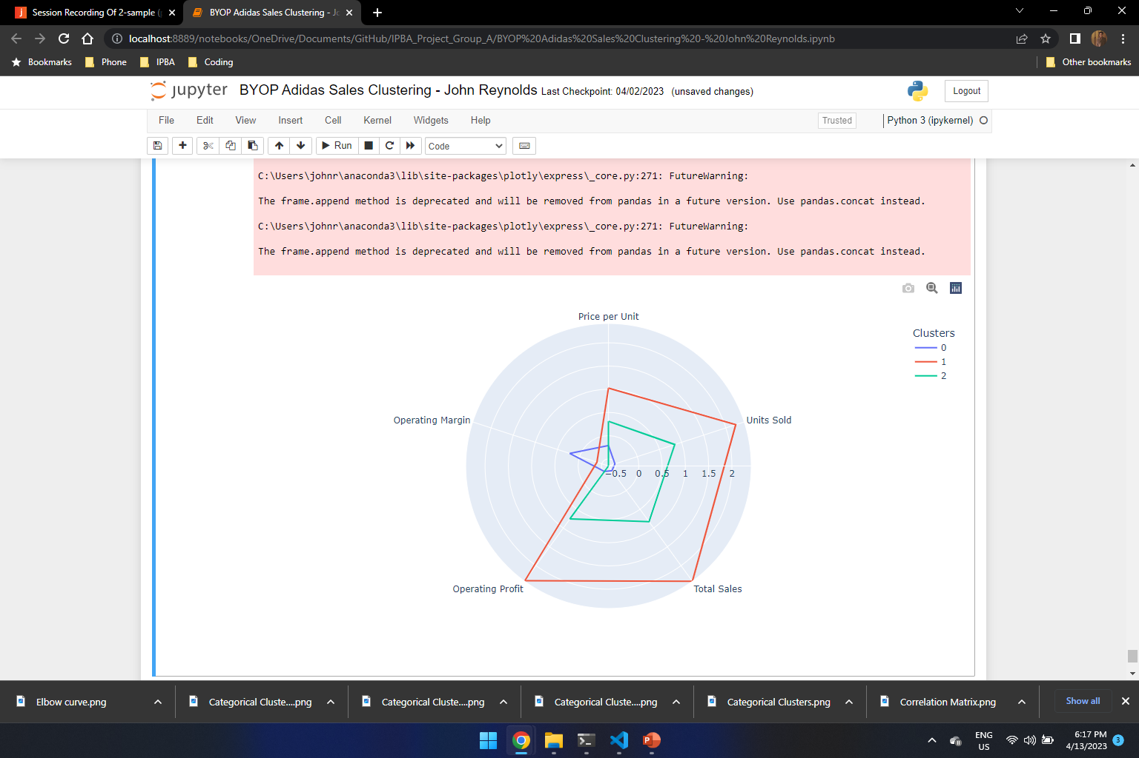
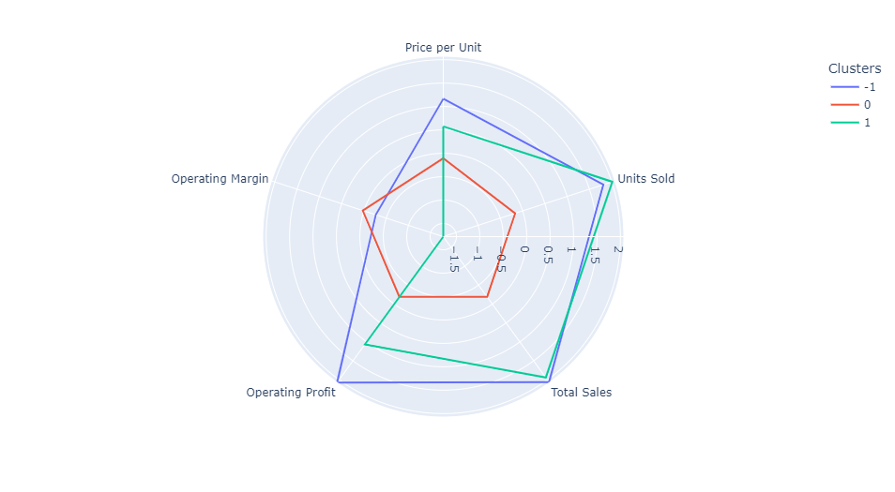
Clustering Technique Selection
K-Means
K-Prototype Clustering
Hierarchal
Clustering
DBSCAN

Slide 27
Selected Model Evaluation

Slide 28
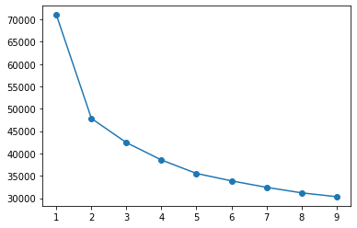
Chosen Model
K-Means Clustering
K-means clustering has been chosen considering its clear distinguishing feature of each cluster characteristics
3 clusters have been passed as the parameter as per the elbow graph and testing the cluster characteristics with higher numbers
The clusters formed distinctly had the following features
Cluster 1 (blue): Low operating margin but the other features are trending high
Cluster 2 (red): Similar characteristics as cluster 1 but the averages for the features are significantly low
Cluster 3 (green): High operating margin whereas the other features are trending comparatively low

Slide 29
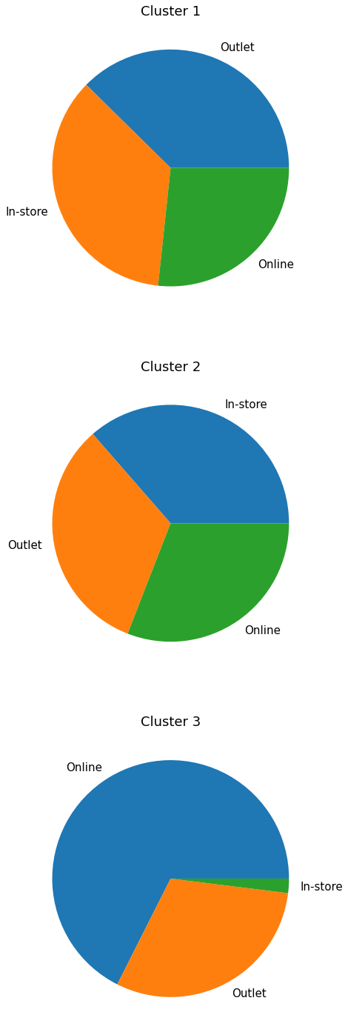
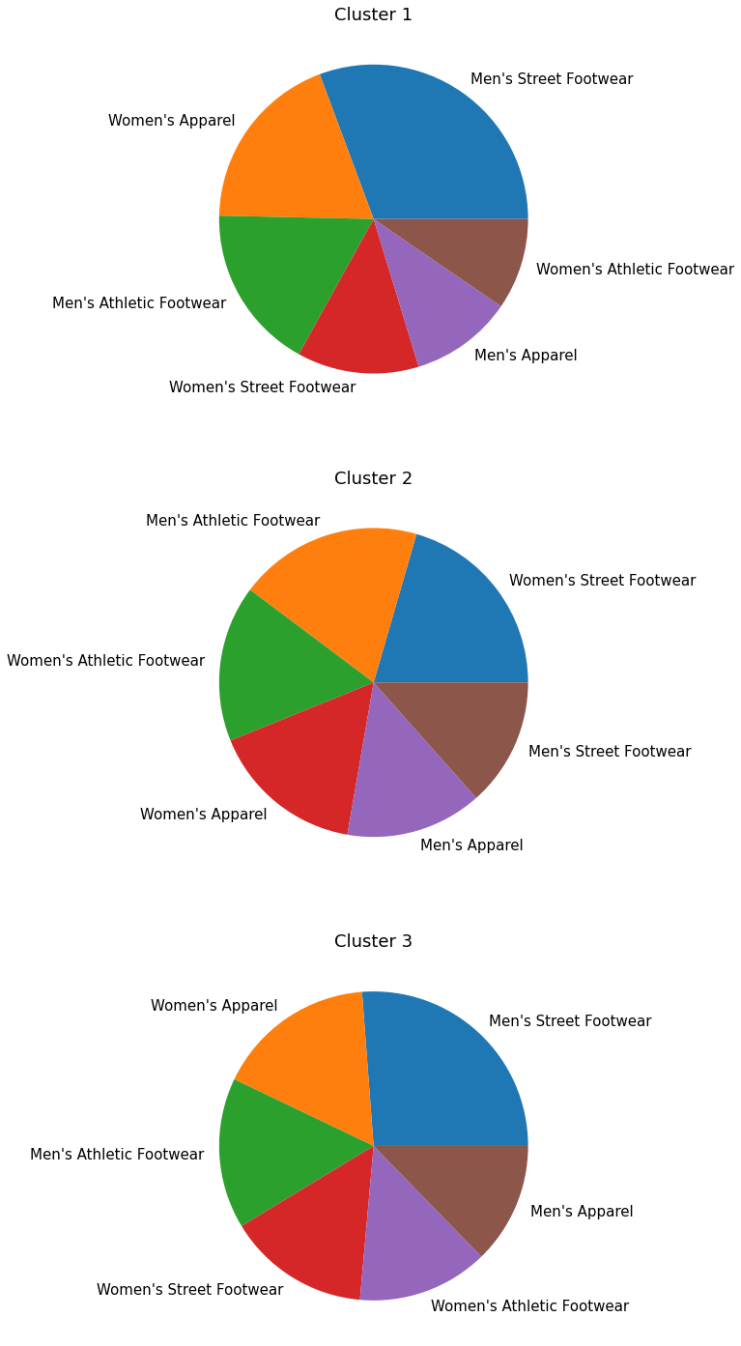
Business Insights From Clusters
Cluster 1 (Low operating margin and high averages of other features)
Sales methods are almost evenly distributed, outlet being highest
Men’s Street footwear is the highest
Women’s apparel is the highest contributed for women products
Cluster 2 (Low operating margin and low averages of other features)
Sales method seem to be evenly distributed
Women’s streetwear is the highest sold item in women’s products
Men’s athletic version footwear is the highest sold item in men’s products
Cluster 3 (High operating margin and low averages of other features)
Online sales are significantly higher
Women’s apparel is the most frequently occurring item
Men’s street footwear is the most sold men’s product

Slide 30
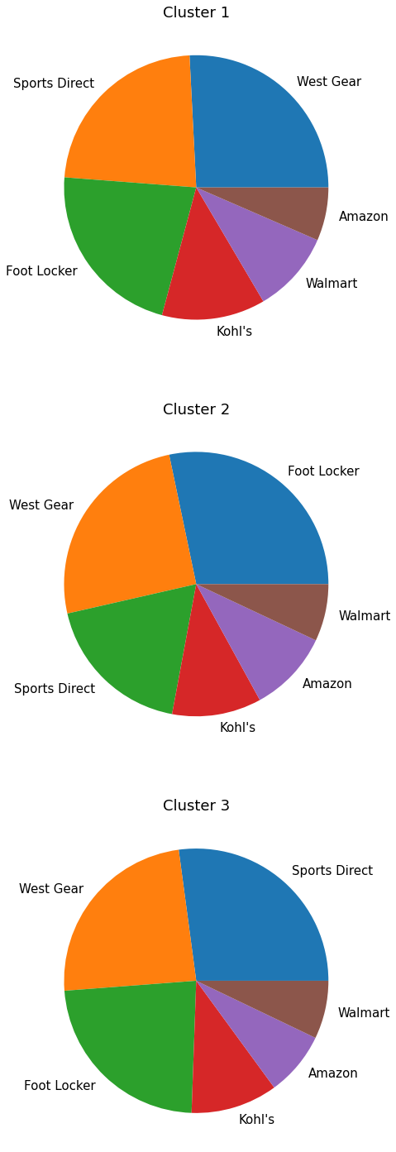
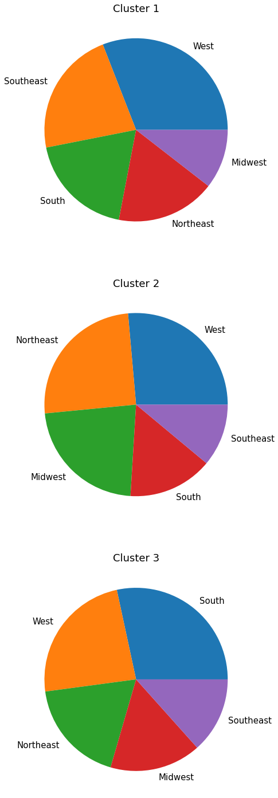
Business Insights From Clusters(Retailer & Regions)
Cluster 1 (Low operating margin and high averages of other features)
Almost equally distributed between West gear and Sports Direct
Prominently hailed in the west and southeastern regions
Cluster 2 (Low operating margin and low averages of other features)
Only cluster where footlocker is the highest retailer in terms of units sold
Prominent in West and Northeastern regions however sales in southeast region stand less
Cluster 3 (High operating margin and low averages of other features)
Sports Direct and West gear are equally distributed in terms of units sold
Heavily oriented in south and west

Slide 31
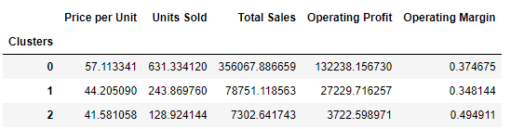
Recommendations
Cluster 2 stores can attract more units sold while maintaining its characteristics of possessing low operating margin if they can promote women’s apparel in women’s products

Slide 32
Analysis Of Results
How do we further improve the model

Slide 33
Business Recommendation

Slide 34
Deployment Strategy

Slide 35
Thank You

